Slide 1
Predicting Aquatic Environment For Fish Species Survival Using IOT and ML
Capstone project
Presented by,
Sumon Ahemed
ID : 1801042
Abdus Sabur
ID : 1801034

Slide 2
Objectives
Develop an Aquaculture Monitoring System.
Remote monitoring of water condition using various sensors and website.
Predict possible Fish Species for optimal survival.
Utilize machine learning models to classify and suggest fish species based on water quality parameters.
Enhance Decision-Making in Aquaculture Management
Provide actionable insights to improve fish farming efficiency and sustainability.
Ensure High Model Accuracy and Reliability
Train and evaluate multiple models, selecting the best-performing Decision Tree Classifier.
Implement a user-friendly web interface for real-time monitoring and prediction.
Optimize resource management and reduce fish mortality rates through precise environmental control.

Slide 3
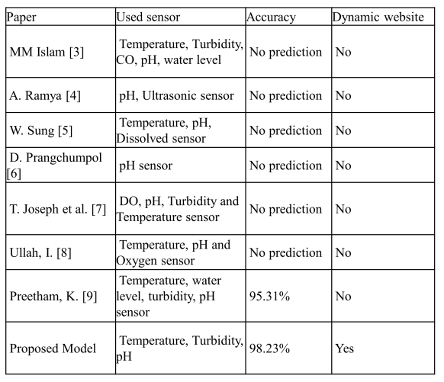
Related Works

Slide 4
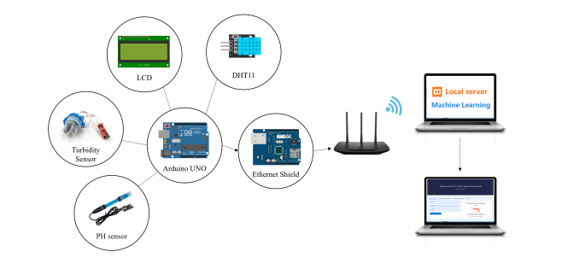
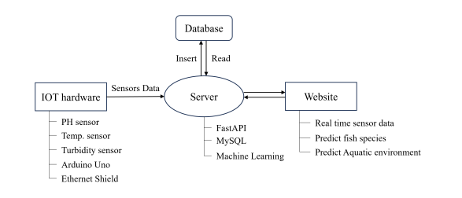
Proposed System
Send sensor data to server
Block diagram of proposed system

Slide 5
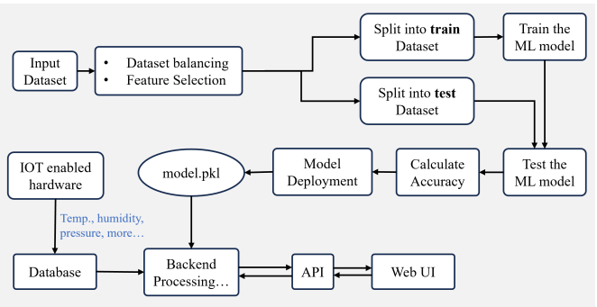
Overall Workflow

Slide 6
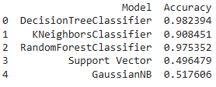
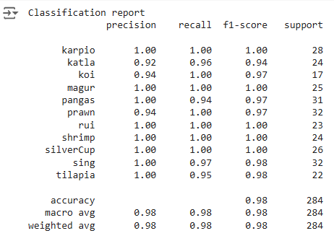
Model Selection
Accuracy comparison
Classification report

Slide 7





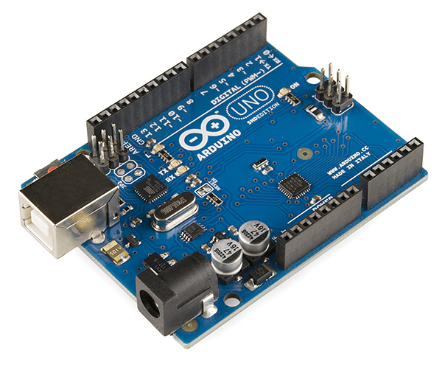


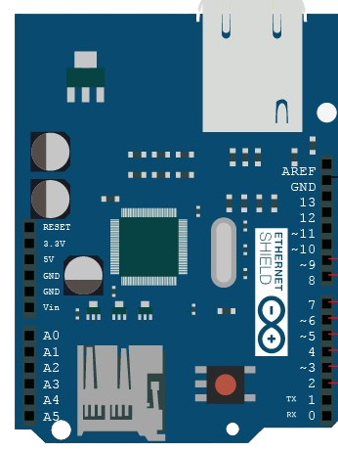

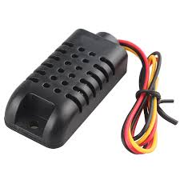







Tools and Technologies
Frontend segment:
API, DB design segment (Backend):
Hardware segment:
HTML
Markup language
VS Code
Software
Arduino IDE
Software
Javascript
Programing language
Python
Programing language
Arduino Uno
Micro-controller
SCSS
Sassy Cascading Style Sheets
FastAPI
Web framework
Arduino Ethernet Shield
Networking Module
ML Model segment (Backend):
Xampp
Software
DHT11
Temp. & Humidity Sensor
Google Colab
Web Application
MySQL
Database management system
PH sensor
Sensor
Pandas
Python Library
Turbidity Sensor
Sensor
Kaggle
Website for dataset
LCD
Actuator

Slide 8
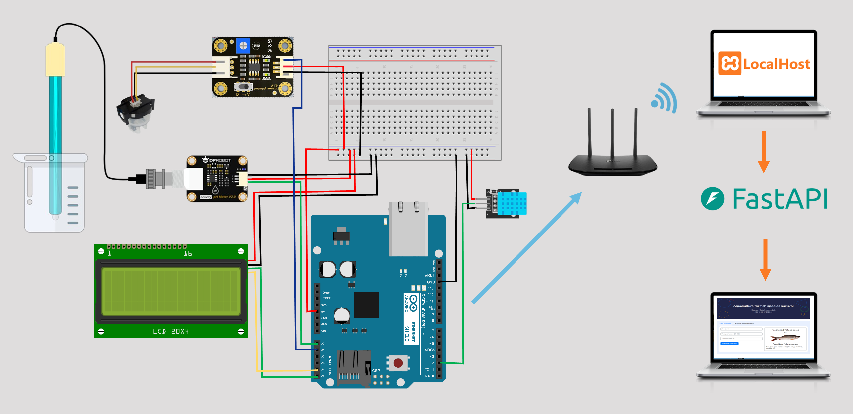
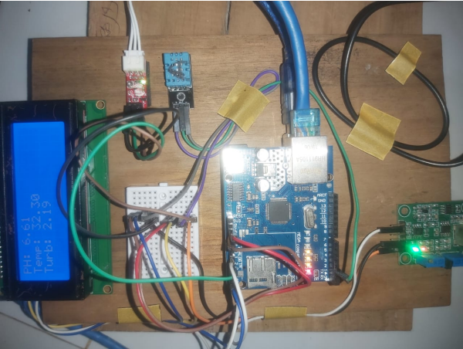
Design and Implementation

Slide 9
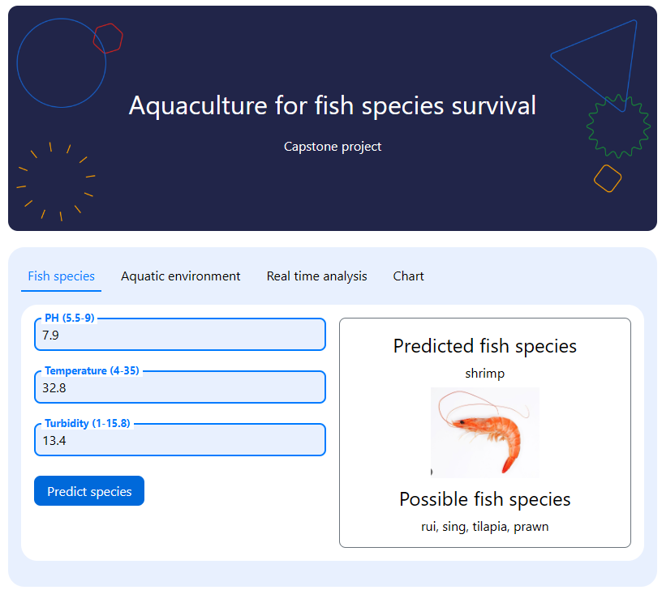
Predict fish species

Slide 10
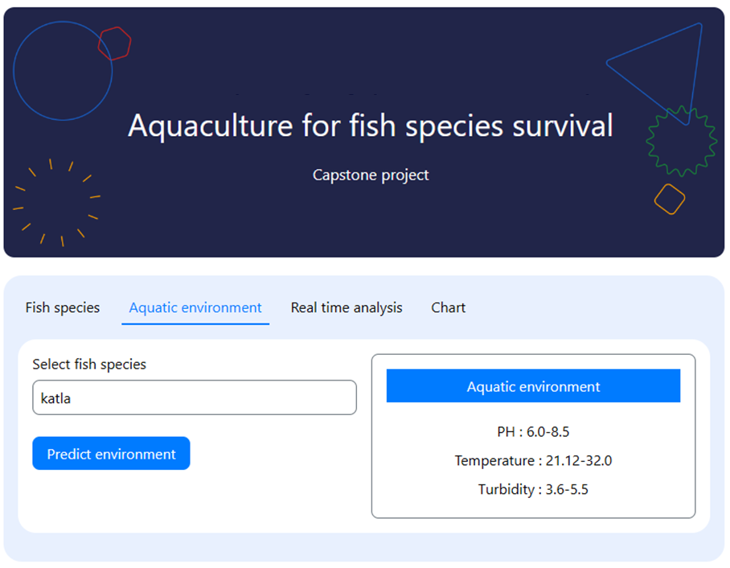
Predict aquaculture environment

Slide 11
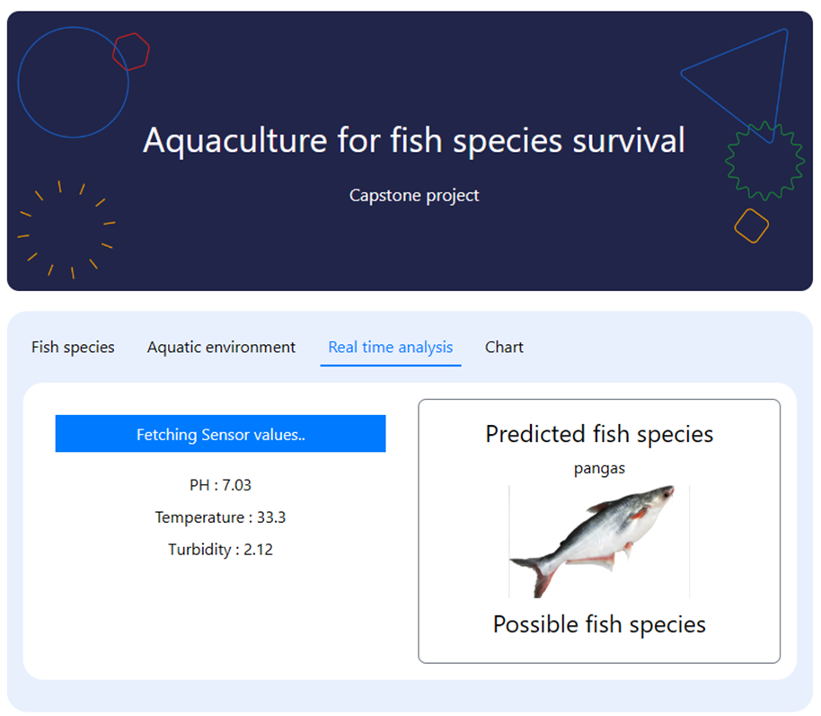
Predict fish species using real time sensor data

Slide 12
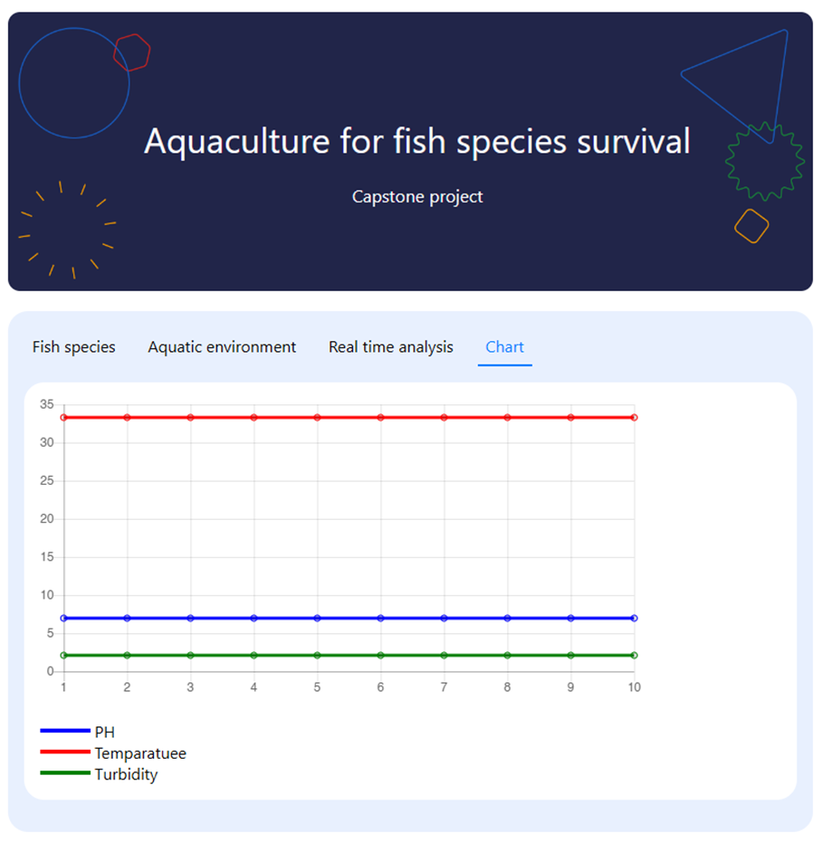
Real time sensor values linechart

Slide 13
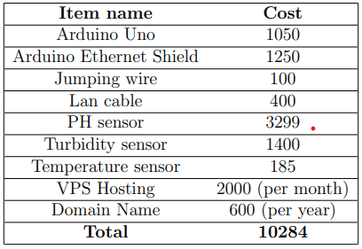
Cost estimation

Slide 14
Thank You

